Slide 1

Bus Transit Prediction
Team BusNet
Brittany Giordano Senior, DSA
Daniel Redder Senior, DSA
Turner Nalley Senior, DSA

Slide 2
Timeline
Ahead of Schedule
Currently Week 11
Deliverable
Week 1 Jan 25th-29th
Team Charter
Week 2 Feb 8th-12th
Data Gathering
Repo Creation
Deliverable II
Week 3 Feb 22nd-26th
Clean Data
Week 4 – Week 5 March 1st-12th
Data Exploration
Week 6 – Week 7 March 22nd-April 2nd
Hypothesis Establishment
Statistical Analysis
Deliverable III
Week 8 April 5th-9th
Neural Network development
Creation of Data Pipeline
Week 8 – Week 10 April 12th-23rd
Visualization & Webserver Development
Testing
Complete
Behind Schedule
Yet to Start

Slide 3
Roles & Duties for Remaining Tasks
Turner
Created and Trained ARIMA model
Automated ARIMA model sending output values to d3.js graph
Brittany
Created d3.js visualization for webpage
Daniel
Designed Main Webpage and map
Setup and Configured Nginx/Uwsgi/Flask webserver
Created and trained LSTM Neural Network Model

Slide 4

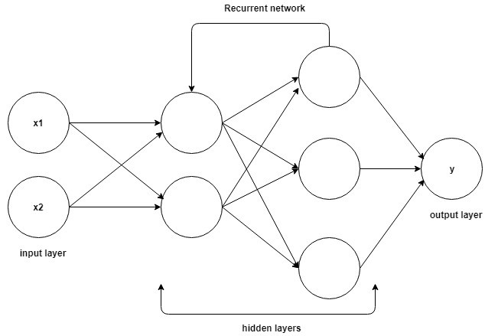











Technologies
Notebook Tools
Webserver
Source Code Management
Analysis Tools
Data Collection / Storage
Notes:
Now we are going to talk about our analysis. Here we are talking about our main notebook with hypothesis related to our main live dataset rather than our individual ones.
I’m going to hand it over to Brittany to talk about her mapping visualization as well as what happened with our other two datasets.

Slide 5
Our Webpage http://busnetcloud.com

Slide 6

Github
bus-transit-prediction

